Slide 1


Slide 2
Market Reach
U.S. circulation of over 48 million magazines a year.

Slide 3
Problem #1
U.S. circulation of over 48 million magazines a year. air and water pollution overflowing landfills climate change

Slide 4
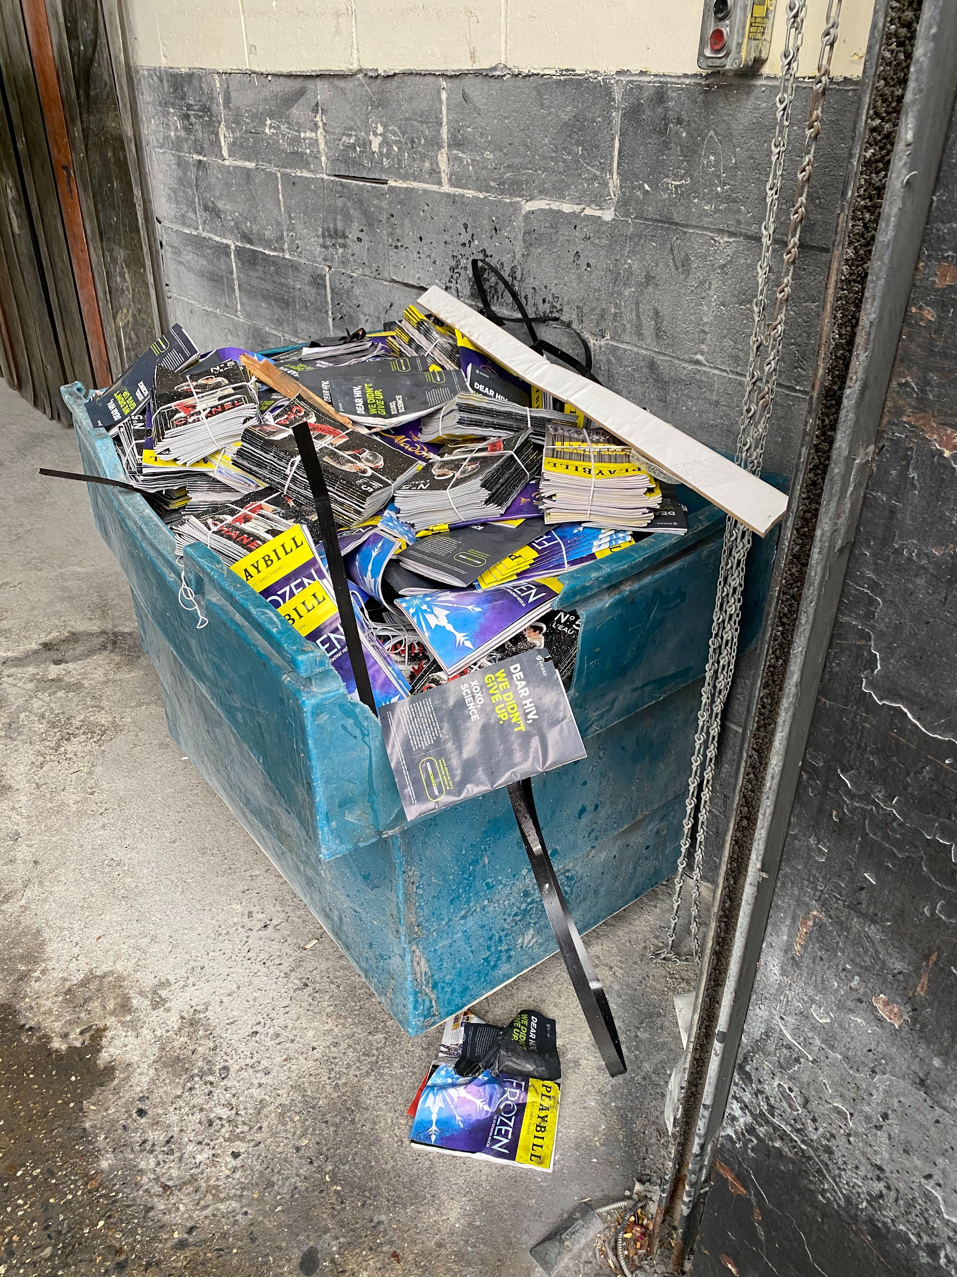
Courtesy, Kristen

Slide 5
Revenue Stream
The printed Playbill is financed 100％ by print advertising revenue.

Slide 6
Problem #2
The printed Playbill is financed 100％ by print advertising revenue. by 2023, digital will account for more than 67% of total ad $. * *eMarketer, https://www.emarketer.com/newsroom/index.php/us-digital-ad-spending-will-surpass-traditional-in-2019/

Slide 7
Challenge
Broadway needs to attract young, growing audiences and...

Slide 8
Challenge
Broadway needs to attract young, growing audiences and… Playbill needs to move its in-theatre magazine model from print to digital ASAP.

Slide 9
+

Slide 10
Solution
a new mobile digital experience that enables users to easily access show information

Slide 11
Challenge
Playbill+ needs to be perceived as a valuable companion or alternative to the ubiquitous printed magazine and/or souvenir so that its demand becomes indisputable

Slide 12
Solution
a new mobile digital experience that enables users to easily access show information, plus...

Slide 13
Need
a new mobile digital experience that enables users to easily access show information, plus... in-theatre venue information, plus...

Slide 14
Solution
offer interactive engagement pre-theatre in-theatre post-theatre

Slide 15
Hypothesis
Playbill needs to adopt a real-time, user-interactive digital model before a competitor does!

Slide 16
Hypothesis
As the current market leader in this space, Playbill can retain its dominant position and ward off potential challengers.

Slide 17
Assumptions
Users will value: access to real-time venue information such as seating maps, bathroom locations, assisted-listening device locations, merchandise and concessions locations premium content additions like theatre insider tips (e.g., shortest restroom lines), behind-the-scenes, etc. pre-show/intermission gamification plays for real-time seat upgrades, concession and merchandise giveaways/discounts, and promotions (go backstage, sit in the pit, etc.)

Slide 18
Assumptions
Users will engage with searchable content, actor/musician video bios, purchase opportunities (e.g., show merchandise, cast/artist albums, discount opportunities, nearby restaurants, shops, etc.) Advertisers and revenue partners will welcome the opportunity for this channel to maximize personalization target opportunities for Broadway’s high-earning demographic If/when digital Playbill+ replaces printed Playbill magazine, we can expect a degree of outcry from long-time theatre enthusiasts and nostalgics Users may want to save/archive their digital Playbills User adoption and engagement will differ based on age

Slide 19
Risks
Minimal user adoption and/or engagement Advertisers are not willing to add to, or shift, their advertising dollars from their allocated print budget Occasional internet “brown outs” during production runs Unforeseen/unknown union/labor/industry restrictions or contracts restricting digital adoption Unforeseen intervention/policy/law changes that make digital connectivity/operations cost prohibitive

Slide 20
Who is the customer?
Anyone who goes to a show.

Slide 21

Persona 1 - Theatre Enthusiast
Persona Characteristics 45 years old female College graduate Sees 15+ shows a year Prioritizes spending time and money for live theatre over other media and all other activities Has ample discretionary time and money to spend Saves Playbills and occasionally references them Goal-oriented Seeks self-improvement Theatre snob; Eats, lives and breathes theatre Open to new things
Persona Goals/Needs Loves being drawn in and engaged in a theatrical experience Loves being intellectually challenged Loves great storytelling Hates waiting for anything Hates not having information at her fingertips Hates distractions
Dev Otedfan

Slide 22
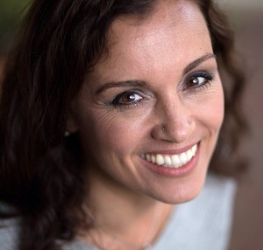
Persona 2 - Entertainment Seeker
Persona Characteristics 40 years old, female Attended 5 shows last year Usually purchased tickets online about 6 weeks before each performance Likes to spend time with friends, family member(s) Likes to reflect on shows and will occasionally post about the show on social media Keeps Playbill as souvenir with all of her other Playbills Likes to purchase a mug, t-shirt or other souvenir as a show remembrance
Persona Goals Loves social interaction and quality time with family and friends Loves entertainment and a “good night out” Loves dinner and a show Love theatre as a hobby, interest Loves good customer service & clean venue facilities Loves watching actors perform Hates bad seats
Tippie Calshowgoer

Slide 23

Persona 3 - Dispassionate Theatregoer
Persona Characteristics Attends a Broadway show once a year Attracted to a particular show Likes what he likes Looks forward to the big event Watches his dollars but is on board with his special night out
Persona Goals/Needs Loves dinner before a show Loves to party after the show Hates when he doesn’t feel he got his money’s worth
Spesh Ellokaysian

Slide 24
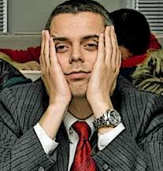
Persona 4 - Disinterested Theatregoer
Persona Characteristics Likes sports, TV, sci-fi, movies, anything but theatre Out of obligation, accompanies/“gets dragged by” his wife to a show once a year Impatient Wants weekends on the couch with a big screen TV and some brewskies In theatre, accepts the Playbill begrudgingly, rolls it up and tosses it under his chair
Persona Goals/Needs Loves physical action Loves to check his phone often Hates plays and musicals Hates when he doesn’t feel he got his money’s worth Hates that he has turn off his cellphone for a show Hates sitting in a cramped theatre
Iz Nottintuit

Slide 25
Who is the customer?
Anyone who goes to a show who might want to… find the nearest exit

Slide 26
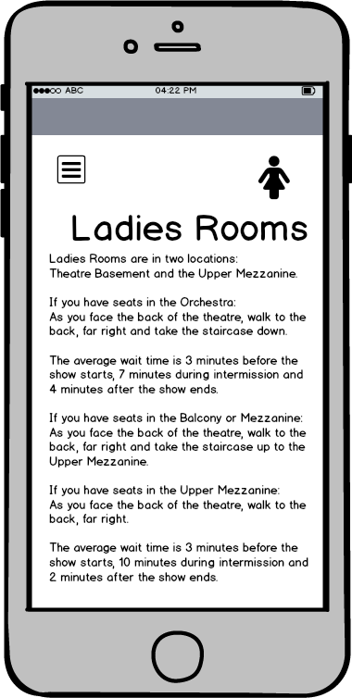
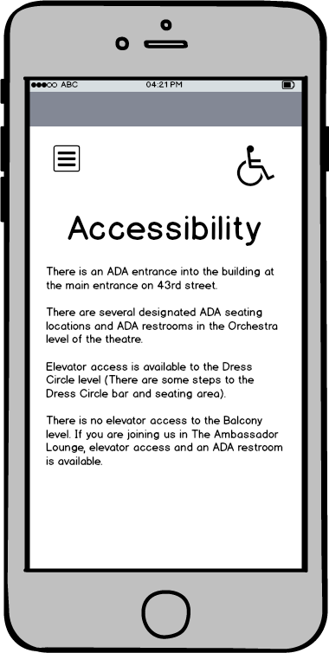
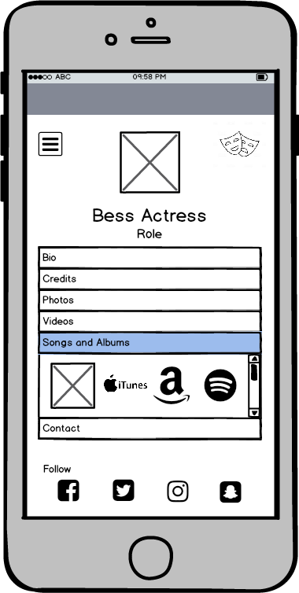
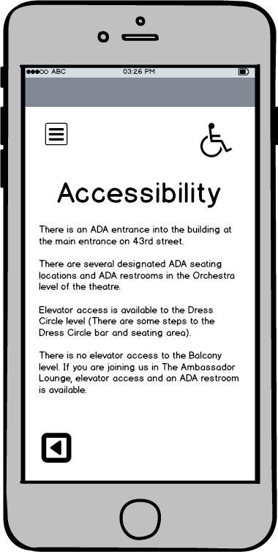
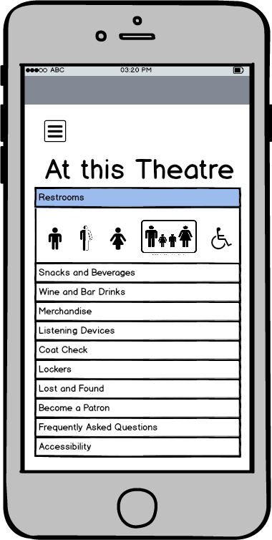

Mobile Ads
x

Slide 27
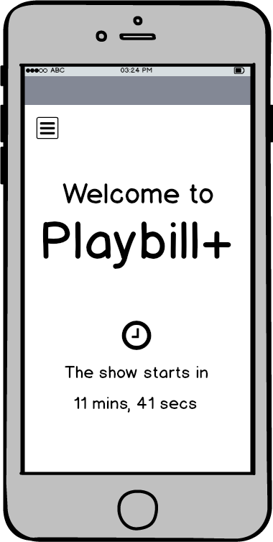
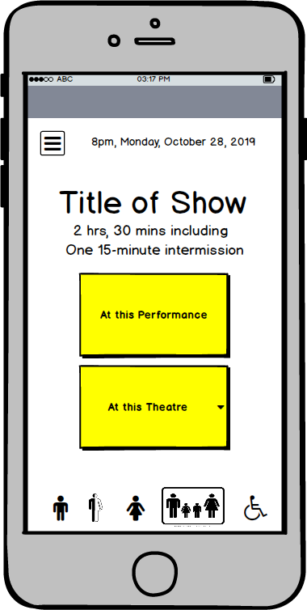
Wireframes
Splash Screen

Slide 28

Wireframes
Splash Screen

Slide 29


Wireframes
Splash Screen
In partnership with

Slide 30

Wireframes
Splash Screen

Slide 31
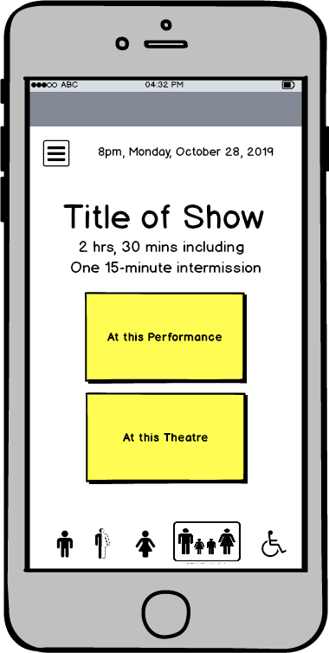
Wireframes
Homepage

Slide 32
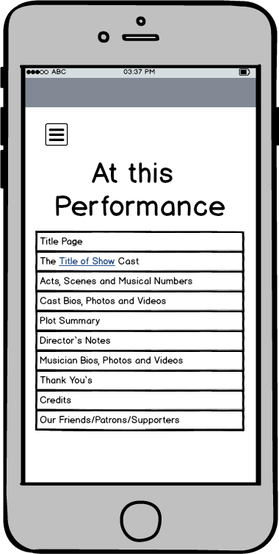
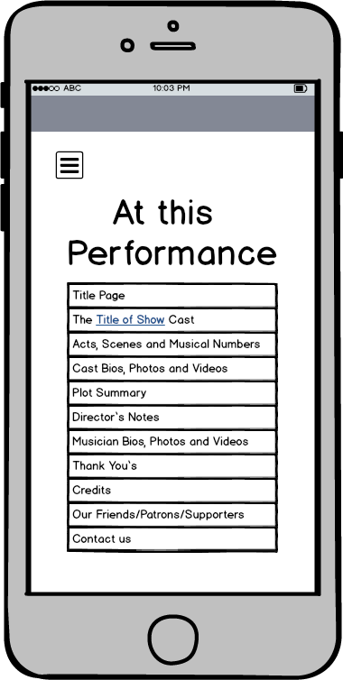
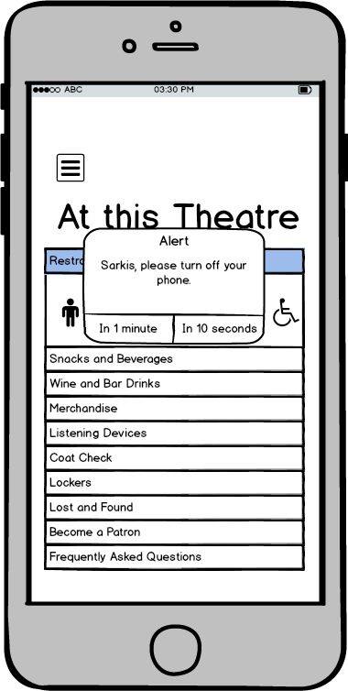
Wireframes
At this
Performance

Slide 33
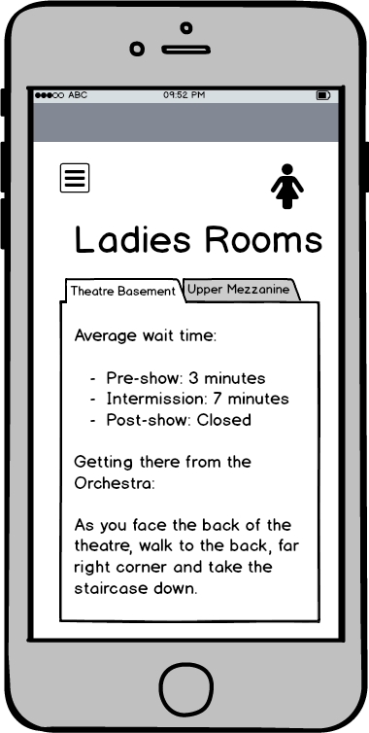
Wireframes
Ladies Rooms

Slide 34
Wireframes
Alert

Slide 35
Roadmap Themes
Theme 1 | Ultimate source for show and producti0n
Theme 2 | Digital-only value
Theme 3 | Quick and easy in-theatre wayfinding

Slide 36
Roadmap 2020 - Minimal Viable Product (MVP)
Q1 | Q2 | Q3 | Q4
Content (show) Pages (flat content) Playbill Store Buy Show Tickets How Many Have You Seen? Celebrity Choice Theatre Quiz (flat content) | Venue Wayfinding (flat content) On the Town: Dining and Drinks | Interactive Cast Bios Stay Connected | Theatre Quiz (scored result) Actor showcases Photo Features, Song Features
Themes | Ultimate source for show/producti0n | Digital-only value | In-theatre wayfinding

Slide 37
Roadmap 2021
Q1 | Q2 | Q3 | Q4
Text Alerts | MyPlaybill | Theatre Quiz (interactive contest) Seat Upgrades | Meet the Actor(s), Sit-in-the-pit, Merchandise Giveaways, Discounts PickMeUp/SendItOver Snacks and Drinks
Themes | Ultimate source for show/producti0n | Digital-only value | In-theatre wayfinding

Slide 38
Market Size - Opportunity
Broadway, Off-Broadway U.S. circulation of over 48 million magazines a year. PLAYBILLder K-12 Schools, Universities, Regional Theatres All Theatre

Slide 39
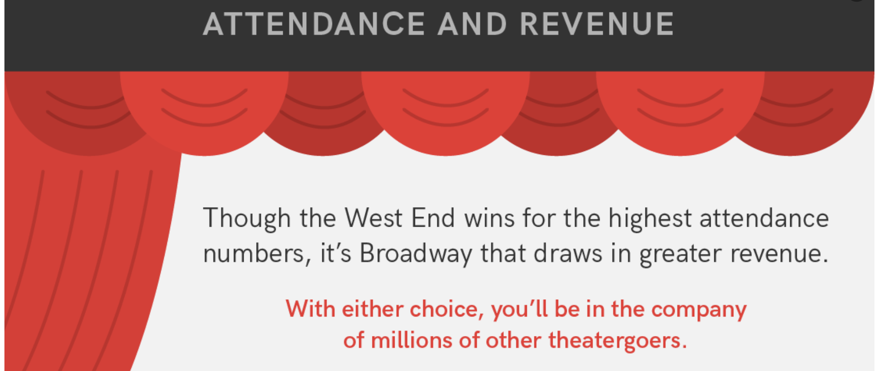
Market Size - Global Opportunity
todaytix.com

Slide 40
Market Size - Opportunity
Broadway, Off-Broadway U.S. circulation of over 48 million magazines a year. PLAYBILLder K-12 Schools, Universities, Regional Theatres All Live Performance All Theatre, Symphony, Dance, Cabaret, Comedy, Magic Shows, Lounge Acts, Speeches, Festivals, etc. All Concerts

Slide 41

Market Size - Opportunity
All U.S. Sports Events MLB NFL NBA NHL MLS

Slide 42
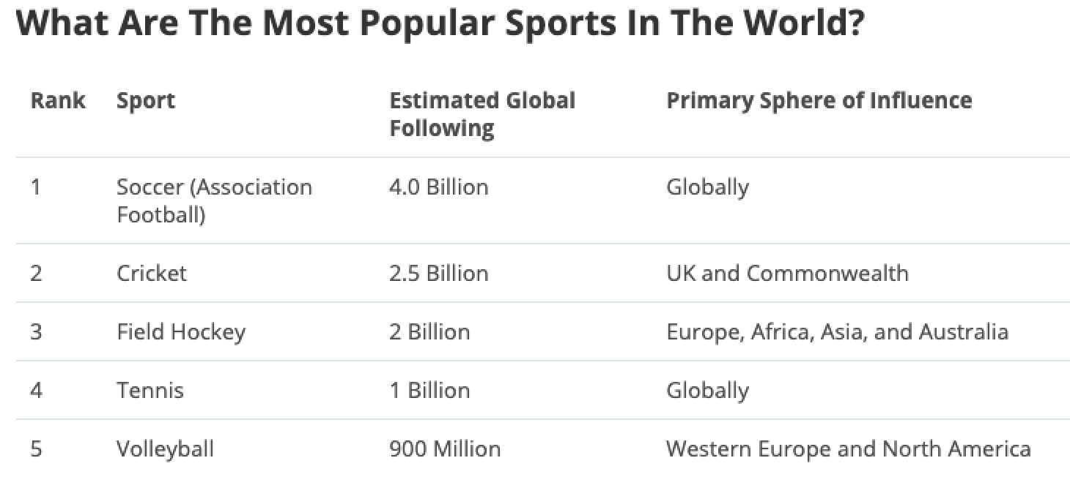
Market Size - Global Sports Opportunity

Slide 43
Market Size - Opportunity
Anyone who attends
Any event as an
Audience member
Anywhere.

Slide 44
THE PLAYBILL

Slide 46
+

Slide 47
+
Curtain.

Slide 48
+
Thank you.

